Slide 1
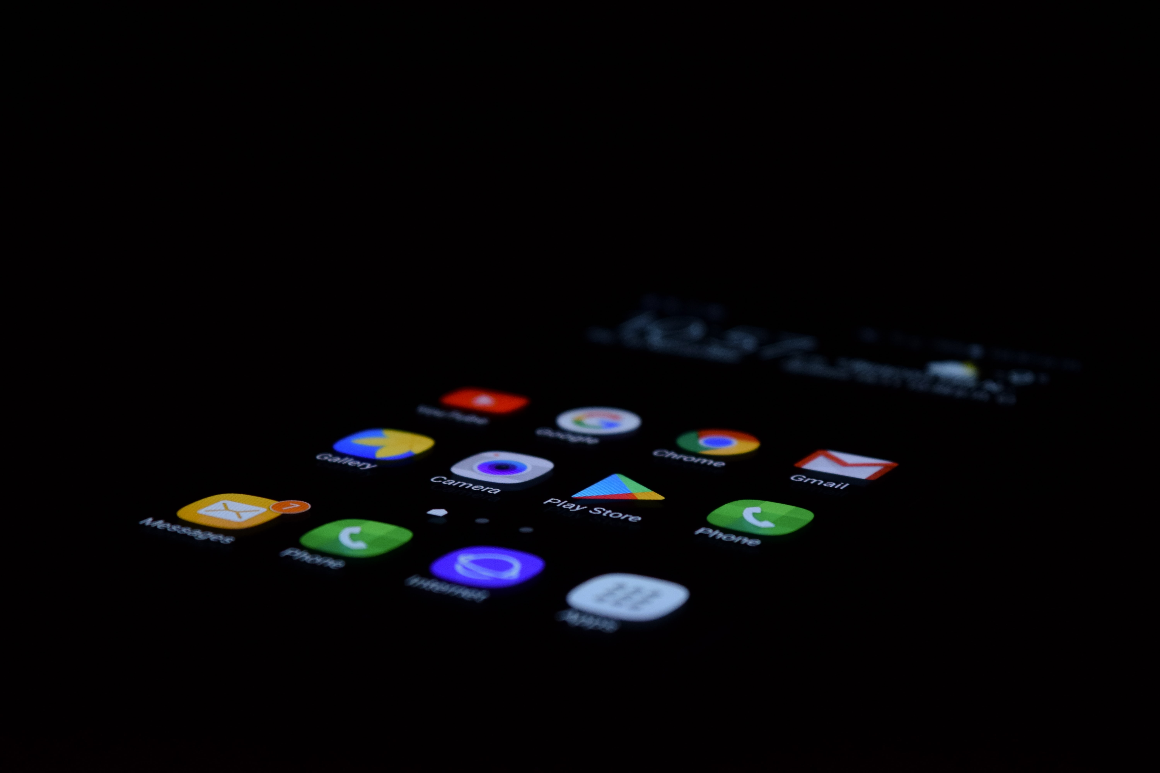
The World of Online Information
Challenging how we source information.
Notes:
Introduction.
“While I agree there are many amazing things to do and learn in a digital world, there are still many things we could be doing with our devices turned off. True, considering the current COVID mayhem, social media has played a huge role in connecting us, the internet has been an asset for continuing education, and keeping us informed. The downside to the electronic world, however, is that we do not know how to function when it’s turned off. Can we?”

Slide 2
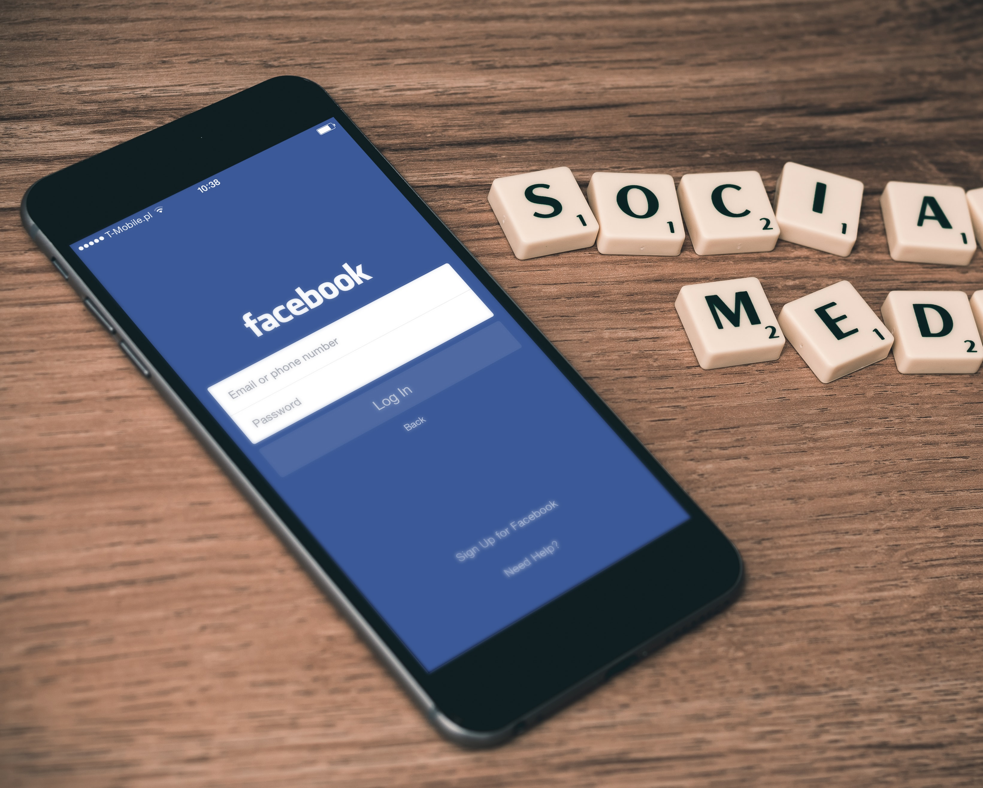
The World of Social Media
& Google Searching
What are the perks?
When is Social Media and Google Searching a benefit
What did they do before?
What can we learn from the old way?
What can go wrong with Social Media and Google Searching?
Make informed decisions
Notes:
Outline.
“Previous generations that did not have an endless connection to the technical world had a different way of living, learning, and doing. While the speed of learning is great online, there are pitfalls. Is social media, “Google.anything”, and other digital mediums better than the old way of life or not? This is the debate. While I believe there are great elements to having the fast connection to worldwide information, there is also a downside. Covering this topic, I purpose to show you that life can be more than digital, it can be lived when our systems are turned off. “
What are the perks? When is Social Medial and Google a benefit?
When is Social Media and other online or digital sources a problem?
What did they do 30 years ago?
What can we learn from the old way?
Were there pitfalls with Media and Information before the world went online?
Making an informed decision.
Conclusion.

Slide 3

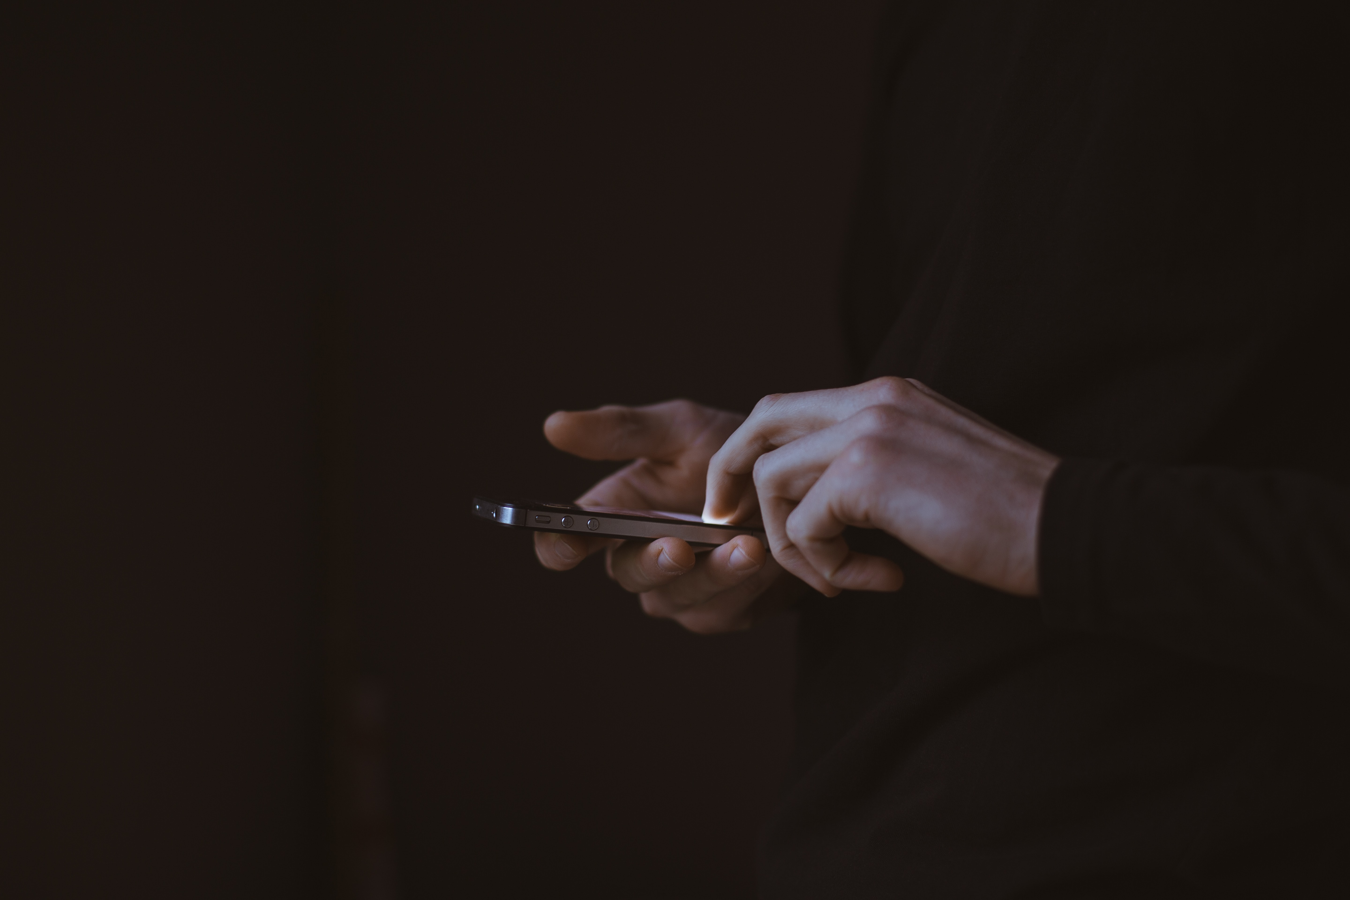
When is Social Media and Google helpful?
News and Weather
Research
Notes:
POINT – NEWS AND WEATHER
“Having information at a moments’ notice is great. We can get up-to-date weather reports, the running score in for our favorite sporting event, follow the news as it happens, etc. You don’t even have to type the question in anymore. You can simply ask your smart friend “Google” or “Siri” and you can have that answer quickly.”
POINT – RESEARCH
“When given a research topic for school, student can quickly find resources and information needed. Customers can post their reviews of good or bad service quickly, so when you are considering your next dining or travel experience, you can find the very best based on customer experiences. Companies wanting to learn about their marketing demographic can resource statistics in their desired area and assess their strategies.”

Slide 4
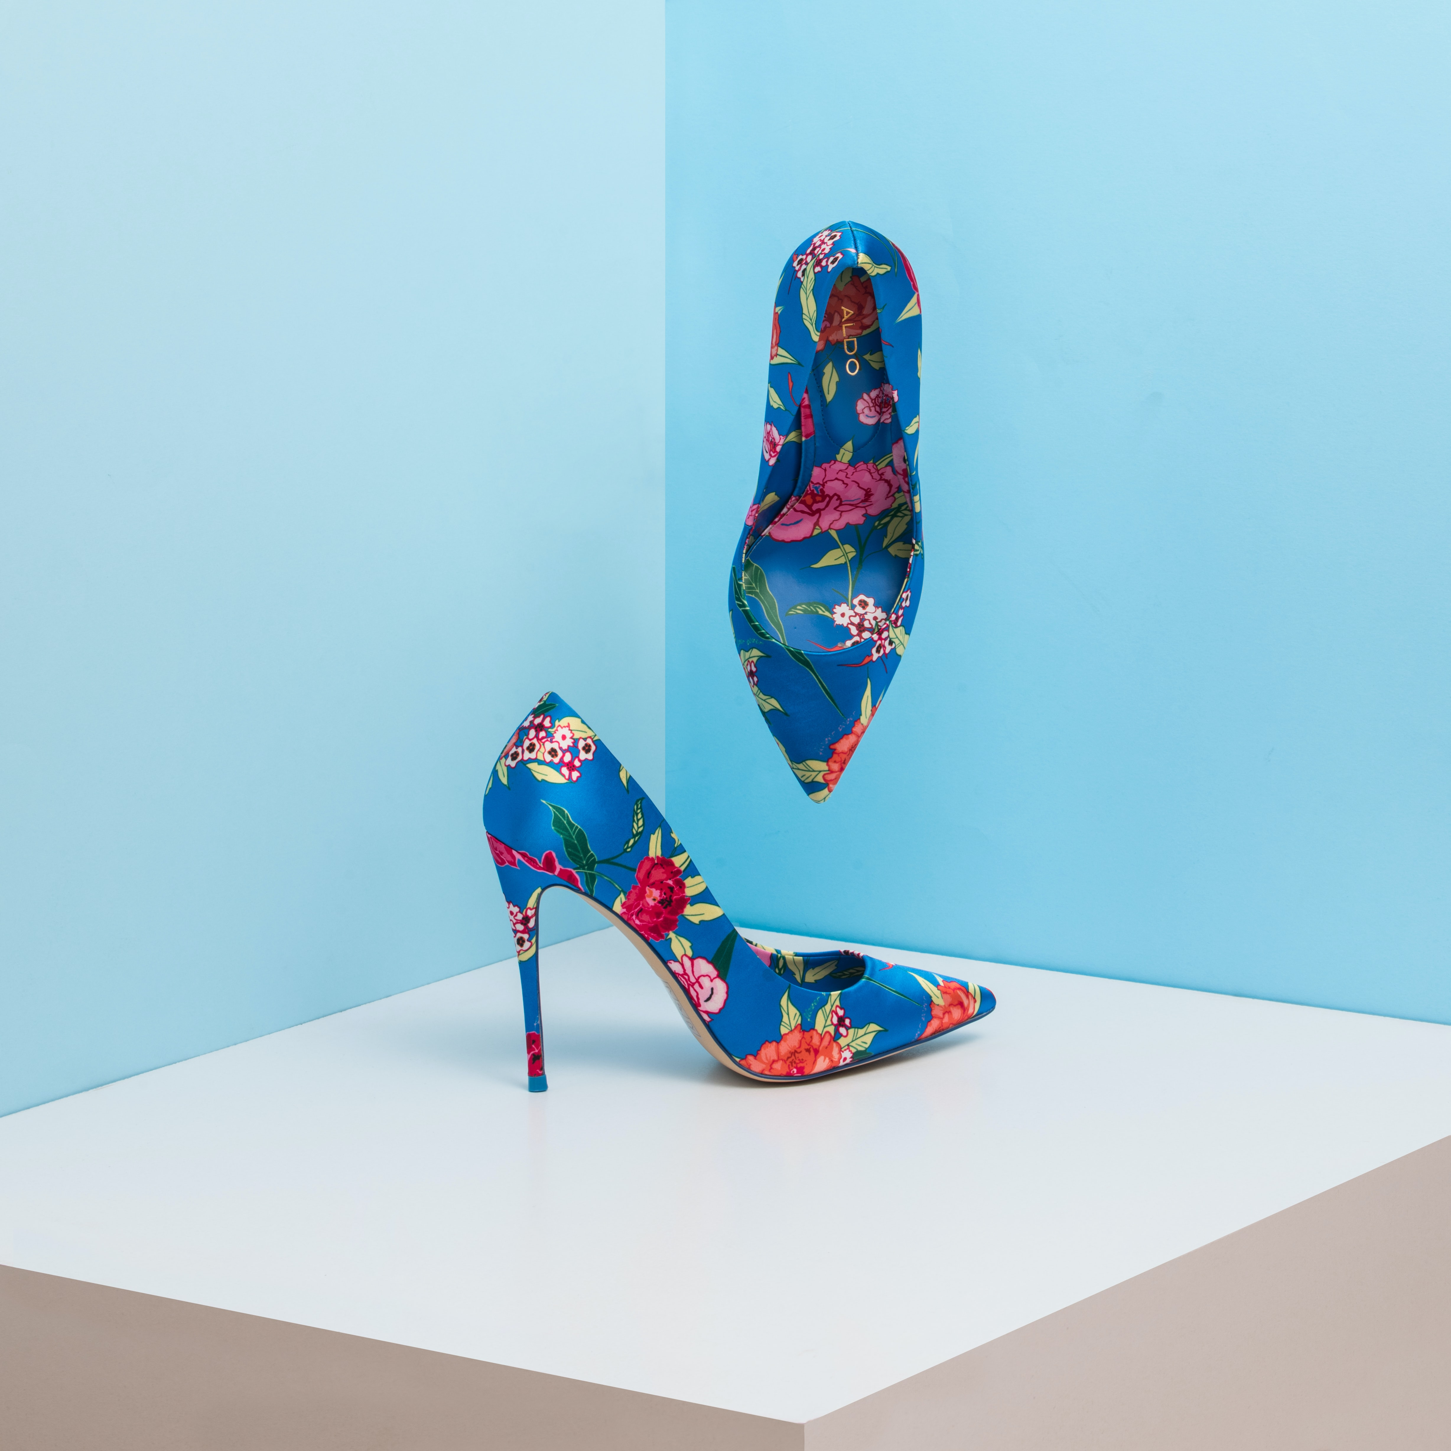

What are the perks?
Shopping
Education
Notes:
POINT – SHOPPING
“Why not mention shopping? We can buy anything online now. Amazon, Wish.ca, Ebay, are just a few sites that have a vast community of buyers and sellers. You can get that movie you’ve been looking for. You can sell that item taking up space in the garage. Shopping online also means no crowds or long lines to get your shopping done. You can even do it in your pajamas. It’s as easy as clicking a button and before you know it, your new shoes are on the doorstep.”
POINT – EDUCATION
“Many classes can take place online. You can earn a degree in many areas of study, while never having to face a classroom. You can avoid juggling a scheduled class time and do so in your spare time. You can learn a new skill by watching online tutorials as well.
There are perks are many, many.”

Slide 5
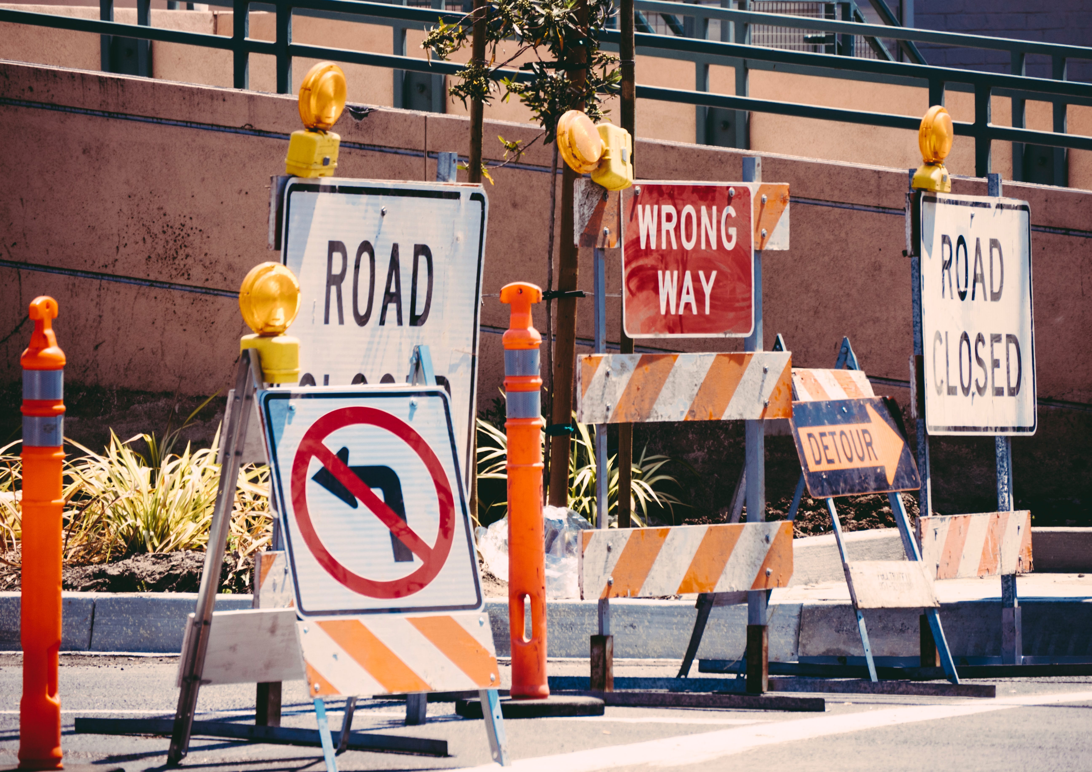
Pitfalls
News Accuracy
Research Pitfalls
Notes:
SCREEN FOUR
When is Social Media and other online or digital sources a problem?
“While Online Resources and Advantages exist, there are some facts you need to be aware of. Do you know where the information is coming from? Is it reliable? Is it rumour or fact based? Knowing the “source” of your “resource” is something to keep in mind, any time you are using the internet.”
POINT – NEWS ACCURACY
“Sometimes fake news travels faster than the truth. It’s like a juicy piece of gossip that you can’t wait to share with another. The problem with gossip, is it’s seldom accurate. One primary, current example is the media mayhem around the COVID-19 pandemic. Information about the virus spread quickly, but a lot of the initial facts were tainted by conspiracies and opinions, rather than informed facts. One such case was blogged by the Ontario SPCA, where several pets were abandoned for fear of the COVID virus being carried by their pet.” (Ontariospca.ca/blog)
POINT – RESEARCH
“There are loads and loads of articles and documents available online. However, some sites are based on opinions or biases. For completing a research paper, you need facts. To make any informed decision, you must have facts. A good way to ensure you are getting fact and not a guestimated opinion, is to know the source. A paper or article published by Global News, CNN, FOX News, CTV, Toronto Star, etc. Will have been researched well. The same holds true when it’s been published by a professional in the field. For example, learning about heart disease from the Heart and Stroke Foundation or Heart Surgeon is a good source, where as Dr. Jane Doe or Dr.Google may not have the facts. Documentation has been collected in fact, that links anxiety with Googling of symptoms. People have misdiagnosed themselves and missed critical facts. A Google Search should never replace a professional medical examination.” (hearth24.com)

Slide 6
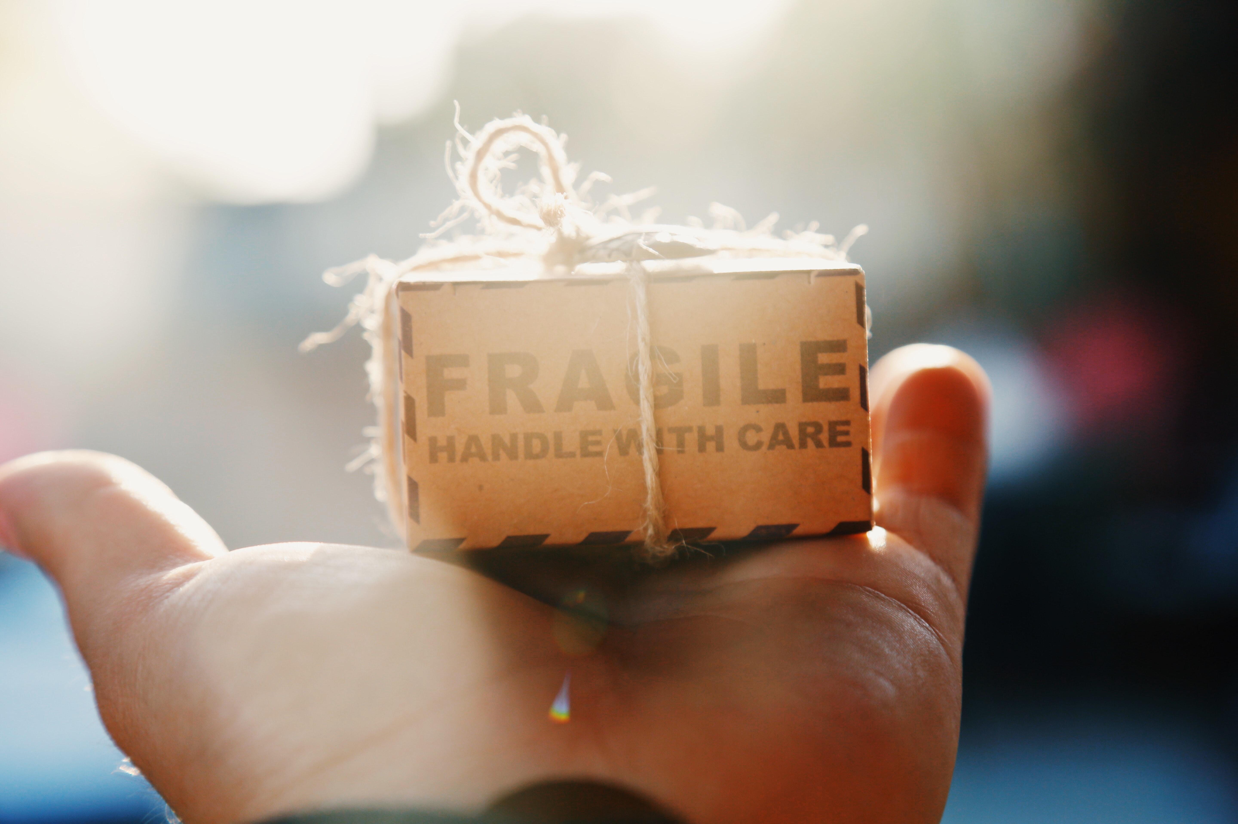

If the shoe doesn’t fit…
Shopping Pitfalls
Education Fails
Notes:
POINT – SHOPPING
“Sure, it’s fast and easy, but there are true pitfalls. Scams are one problem, but there can also be issues with quality. Have you ever ordered an item online, convinced it was great deal, only to discover that this product was nothing more than a cheap piece of …... Well you know what I mean. You can’t try them out first. You can’t try them on. Returning them can be a hassle. Not to mention the risk of putting your credit card and personal information online can open you up to Identity Theft scandals.” (advantages.ca)
POINT – EDUCATION
“While some things can be learned from home, there is something to be said for face-to-face interaction, classroom collaboration, and hearing/seeing your instructor’s lectures. The other side is that you can’t always learn online. Some things need to have a hands-on aspect to ensure you understand what you are doing. Imagine if your surgeon got his/her degree from his living room?”

Slide 7
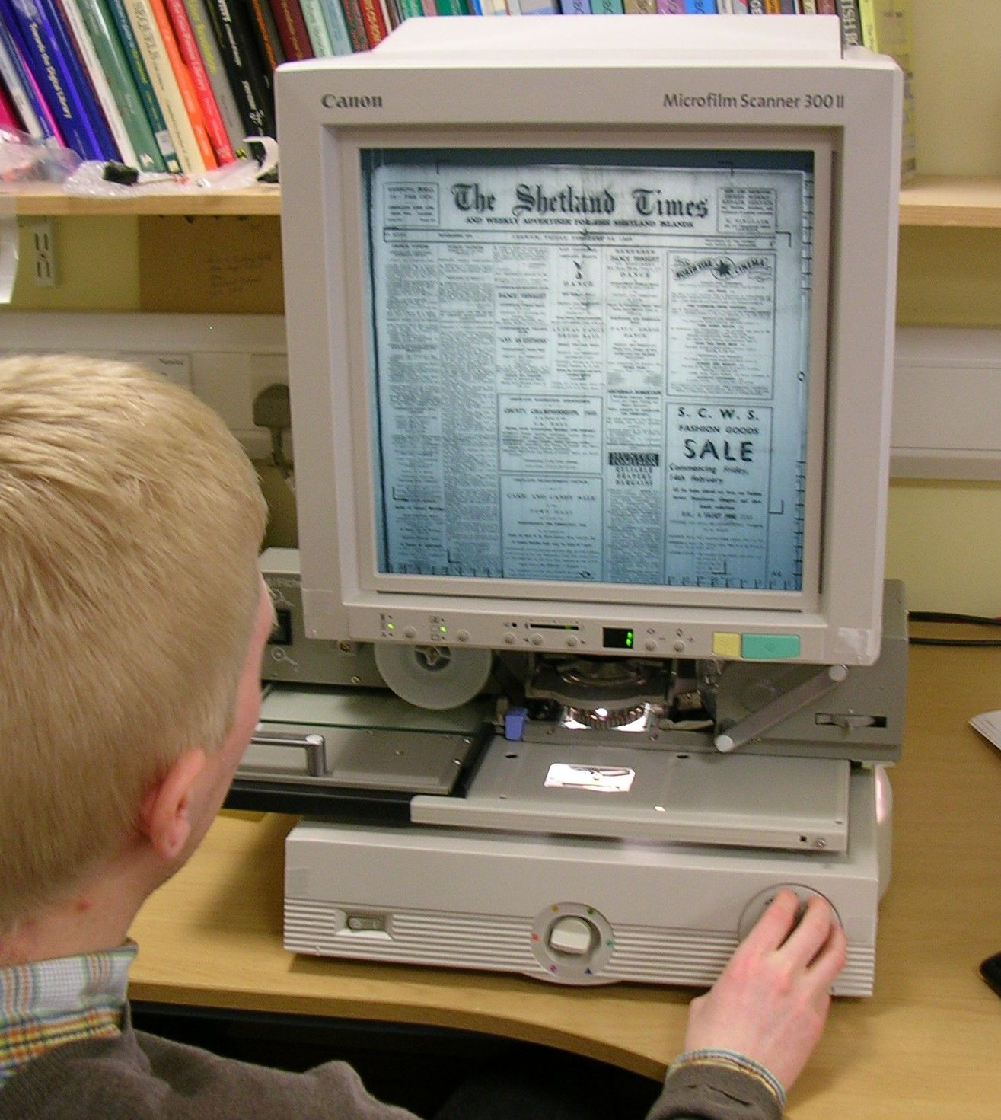


What did they do before Social Media and Search Engines?
Pen & Paper
Deeper Reading Discoveries
Learning from the Elders
Notes:
POINT – PEN AND PAPER
“Obviously, life looked quite different 30 years ago or so. Life before the technical everything world, we used pens and pencils to write letters, a basic calculator or our minds or pen and paper, we talked to our peers face-to-face, the list goes on. We didn’t have the internet to give us information quite so quickly. We would have to go to a library, check out a book or twelve. We could use the microform (image provided) pieces of clipped articles were put upon plastic sheets and viewed through a large window. It was slow, but efficient for its time. The internet does have the information we seek, however, sometimes an in-depth version is better sourced tangibly.”
POINT – DEEPER READING
“Another point, we didn’t have cut’n’paste options. We couldn’t simply highlight our fact and paste it into a project. We had to either write it out or type it out. This often forced you to go deeper into finding the gist of what you wanted to say.”
POINT – LEARNING FROM OUR ELDERS
“Also, we had the benefit of learning from those who had gone before. Humans learned from one another. The indigenous way of life was to learn from your older tribe members, who passed their wisdom down. Albeit, there is much elders can learn from the younger generation too. Still, learning from our historical society has merit.”

Slide 8
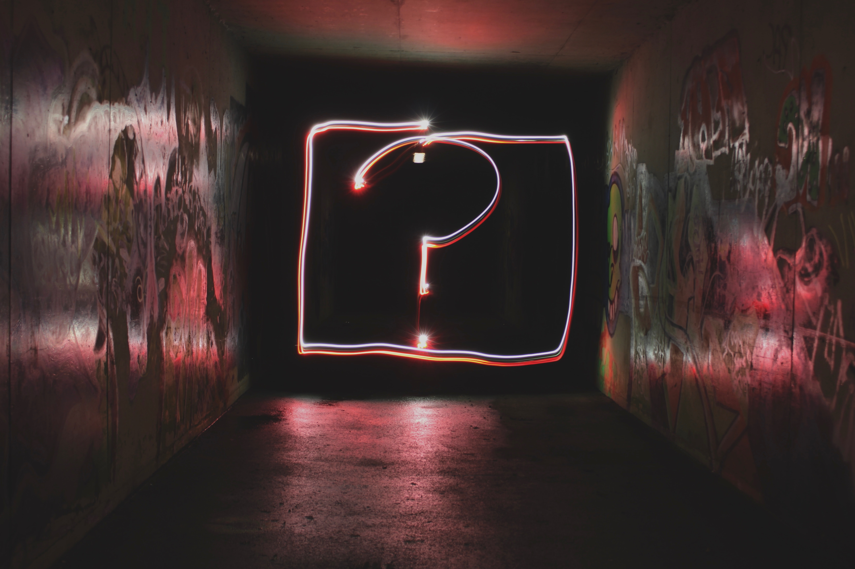

What can we do to ensure accuracy?
Ask Questions
Research, Re-Research, and then Re-Re-Research
Notes:
What can we do to ensure accuracy and security when using the world of online information?
Don’t take assume your information is accurate. Ask questions. Research it. Re-research it, and then re-re-research it. Be thorough…
Ensure your sources are reputable. It’s okay to question what you’ve heard or read. It’s okay to take a moment to double check and even triple check your information. Keep note of resources that have been accurate and which ones are not. Ask, is this an opinion? Is the source reputable?

Slide 9
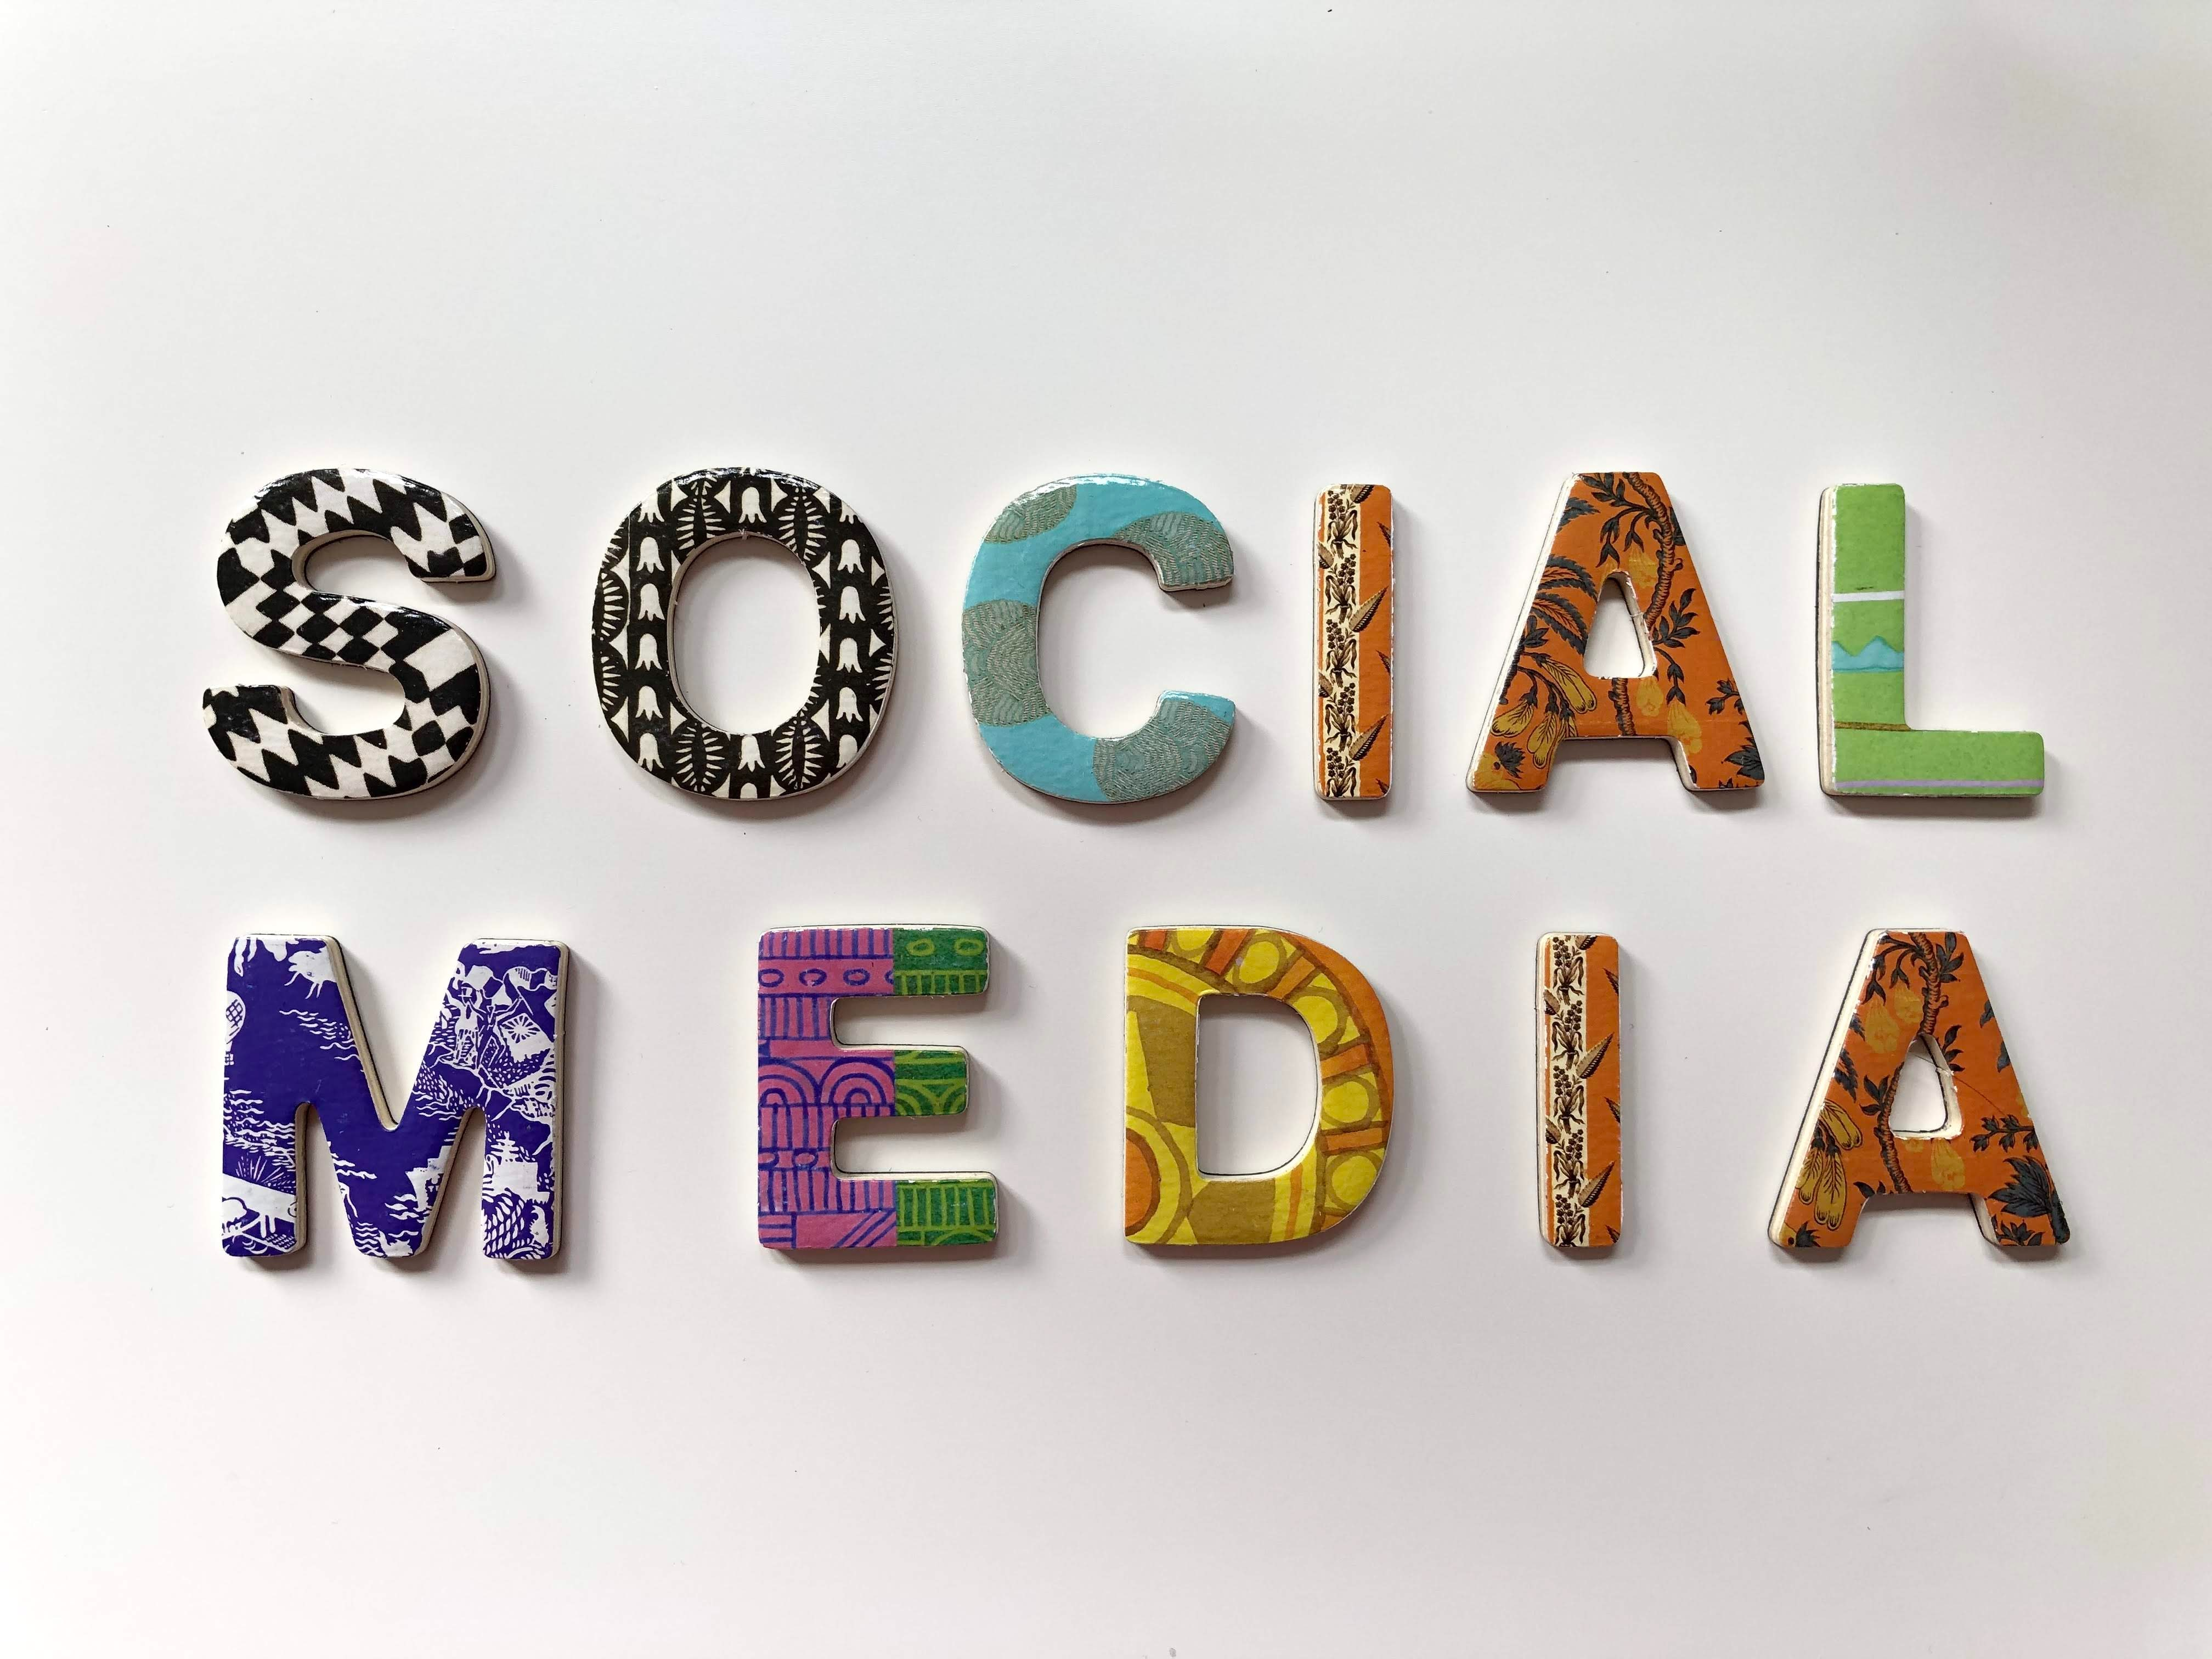
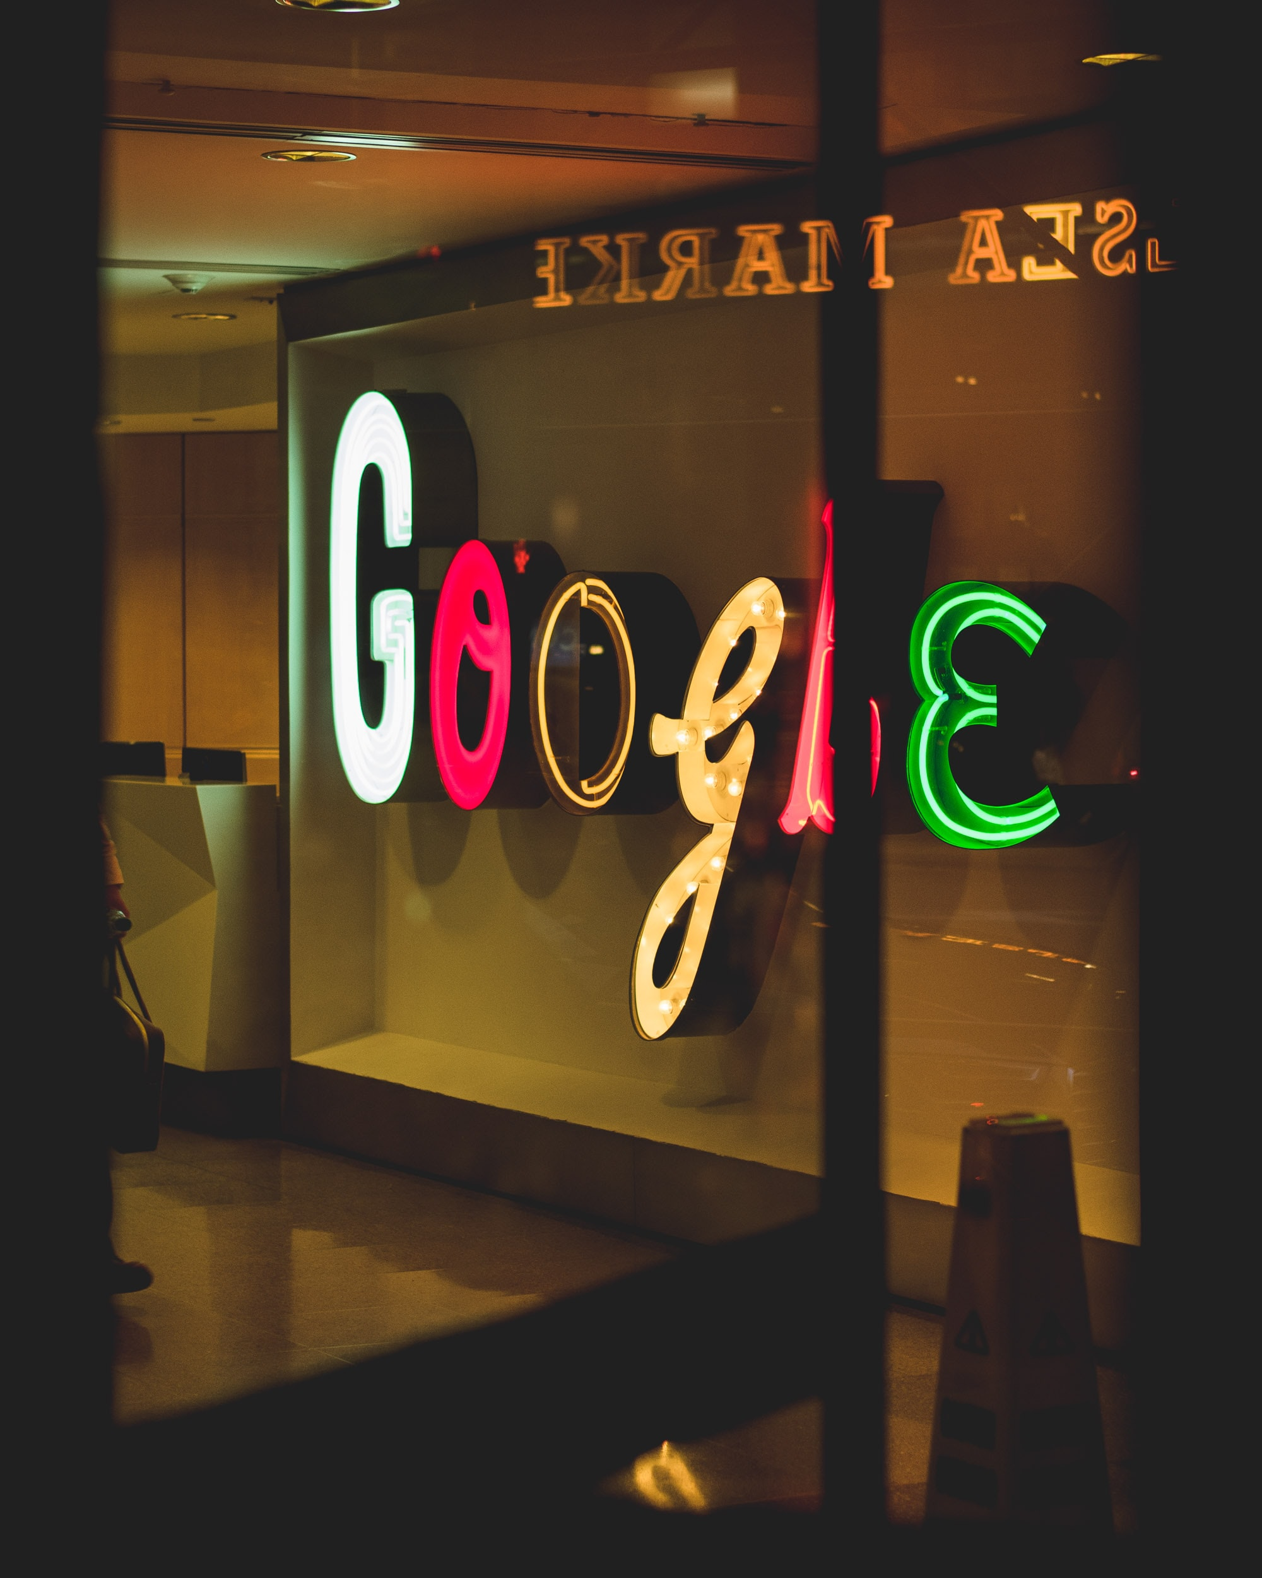
Conclusion
Check
Double Check
Be informed
Ask Questions
Make an informed decision
Notes:
Information is available at a fingertip or voice prompt, but that doesn’t mean it’s always correct. Take the time to know the facts from the lies before making conclusive decisions. When you share a piece of information, make sure you have the truth available. Fear and mayhem are spread by lies. Don’t participate in spreading false information, be thorough and people will learn to trust your judgement and shares in the future. Be informed, accurately.

Slide 10
Resources
Academia, Stack Exchange, (2020), How did researchers find articles before the Internet and Computer era, https://academia.stackexchange.com/questions/132376/how-did-researchers-find-articles-before-the-internet-and-the-computer-era
Cook, E. (2020, March 25), COVID-19 and your pets – Fact vs. Fiction, General Pet Care, Interesting, https://ontariospca.ca/blog/covid-19-and-your-pets-fact-vs-fiction/
Mangis, L. (March 25, 2020), 10 pitfalls of online shopping, https://www.advantageccs.org/blog/10-pitfalls-of-online-shopping
Norman, S. (2016), 5 Advantages of Online Learning: Education Without Leaving Home, ELEARNING BASICS, https://elearningindustry.com/5-advantages-of-online-learning-education-without-leaving-home
Jain, A. (2018), Top 10 Benfits of Online Shopping, (and 10 Disadvantages), https://toughnickel.com/frugal-living/Online-shopping-sites-benefits
Kubala-Chuchnowska, (December 5, 2018), Work at PressPad Digital Publishing, https://www.quora.com/Why-has-online-news-become-popular
Sadmin, M. (2015), Beyond the Likes and Tweets: How Social Media Can Benefit News Publishers, https://mediaspectrum.net/how-social-media-can-benefit-news-publishers/
University of Colorado, (March 19, 2020), https://www.colorado.edu/history/undergraduates/paper-guidelines/using-internet-research

